Slide 1
APUSH Review: Key Concept 2.1
Period 2: 1607 - 1754
Everything You Need To Know About Key Concept 2.1 To Succeed In APUSH
Updated for the 2015 revisions

Slide 2
The New Curriculum
Key Concept 2.1 “Europeans developed a variety of colonization and migration patterns, influenced by different imperial goals, cultures, and the varied North American environments where they settled, and the competed with each other and American Indian for resources.”
Page 30 of the Curriculum Framework
Big ideas:
What were similarities in colonization among the Spanish, French, Dutch, and English?
What were the experiences like with Native Americans with these European countries?
How and why did slavery evolve in these colonies?
How did climate and geography affect British colonies?

Slide 3
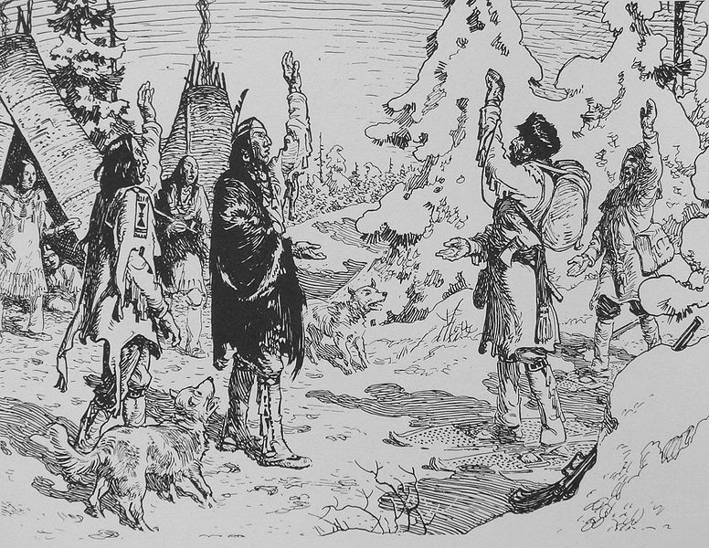
Key Concept 2.1, I
“Spanish, French, Dutch, and British colonizers had different economic and imperial goals involving land and labor that shaped the social and political development of their colonies as well as their relationships with native populations.” - Page 30of the Curriculum Framework
A) Spain established strict control over colonization and converted and exploited many natives
A major goal of Spain was to make $
All trade must go through a few Spanish controlled ports
Small amount of Spaniards ruled indigenous population
Spain sought to convert natives to Christianity, forced many into the encomienda system, and used as trading partners
B) French and Dutch colonization:
Both countries sent few Europeans and built relationships with the Natives
French – intermarried with natives and built extensive trading partnerships
Coureurs de bois – French fur traders – trade beaver furs; would live among natives
Dutch – Like the French, the Dutch build extensive trade routes – mostly in NY
Encouraged settlement of the New World – New Netherland

Slide 4
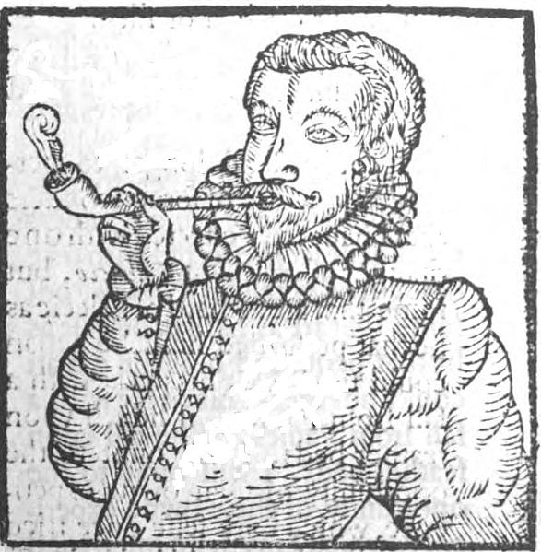
Key Concept 2.1, I
C)English Colonization:
Large number of immigrants
Both male and female – unlike other European countries
Sought economic prosperity, religious freedom (Puritans), and better living conditions (England was overcrowded)
English colonies also welcome immigrants from other countries
Colonies were based on agriculture
Tobacco became a large cash crop
Headright system encouraged immigrants – benefitted the wealthy
Unlike the French and Spanish, English colonists sought to live separately from Native Americans
Conflicts with natives – Powhatans, Bacon’s Rebellion, Pequot War, King Philip’s War

Slide 5
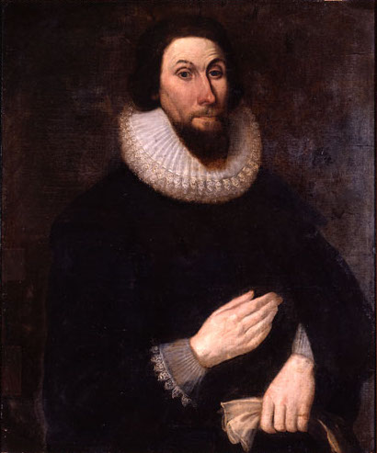
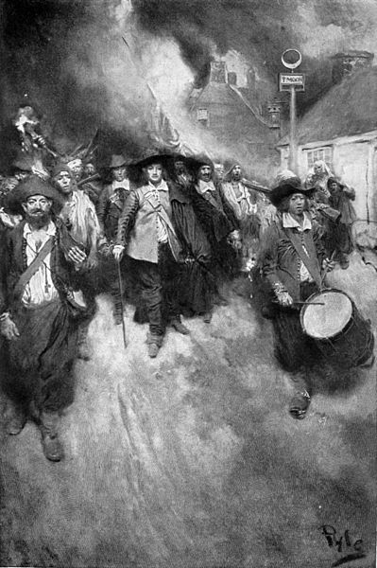
Key Concept 2.1, II
“In the 17th century, early British colonies developed along the Atlantic coast, with regional differences that reflected various environmental, economic, cultural, and demographic factors.” - Page 31of the Curriculum Framework
A) Chesapeake colonies (MD and VA) and North Carolina:
Relied heavily on tobacco – plantations developed – long work days and growing seasons
Exhausted land – led to expansion and conflicts with natives (Bacon’s again!)
Up to the late 17th century, most labor was made up of indentured servants
After Bacon’s Rebellion (1676), there was a switch to African slavery
B) New England colonies:
Established by Puritans (wanted to purify the Anglican Church – John Winthrop)
Established small towns with small farms
Schools were established for towns with 50 families; extended families were common
Some agriculture, fishing, commerce – Boston becomes a major port city
Colder climate, rocky terrain did not allow large plantations

Slide 6
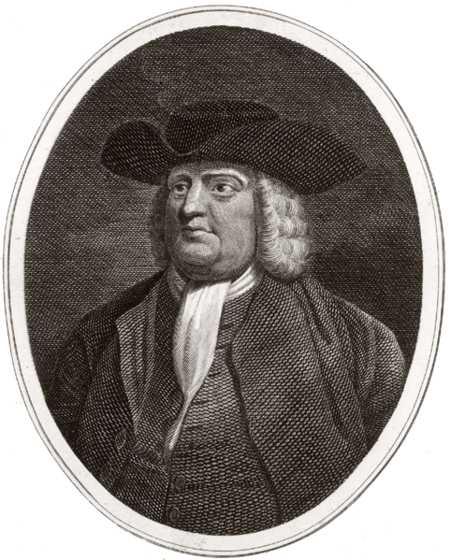
Key Concept 2.1, II
C) Middle Colonies:
Tended to be the most diverse demographically, religiously, and ethnically
Quakers in Pennsylvania (William Penn) – religiously tolerant
Women in Pennsylvania had more rights – Quakers allowed women equal positions in church
Immigrants from Germany
Economy was based on the exportation of cereal crops - wheat
D) Southern colonies and West Indies:
In South Carolina and Georgia, rice was a major staple crop
Very arduous labor – long days and long growing season
Many white laborers refused to work in rice fields – led to an increase in slave labor
In the West Indies (Barbados) sugar cultivation was a major part of the economy
Like South Carolina and Georgia, slave labor was heavily used
In many instances, slaves made up a majority of the population
Led to the development of slave codes – laws to regulate slave behavior
Gave incredible power to slave owners

Slide 7
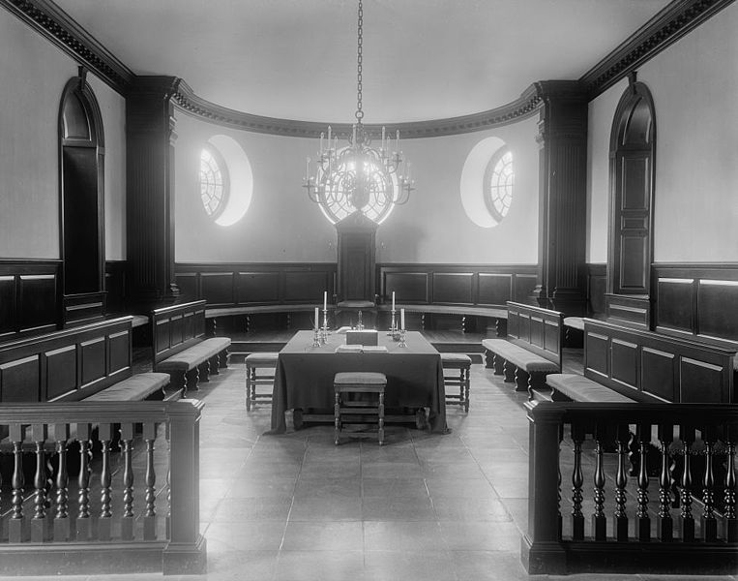
Key Concept 2.1, II
E) Emergence of democratic, self-government in the British colonies:
Caused by:
Distance from Britain
Lax attention (Salutary Neglect – “hands-off” approach to the colonies)
New England colonial government:
Town meetings -> elected legislatures
White, land-owning, church members could vote
Southern colonial government:
Planters dominated assemblies
Virginia House of Burgesses – 1st representative government in British colonies, many members were elite plantation owners

Slide 8
Key Concept 2.1, III
“Competition over resources between European rivals and American Indians encouraged industry and trade and led to conflict in the Americas.” - Page 32of the Curriculum Framework
A) Atlantic economy:
Exchange of goods, African Americans, and Native Americans between Europe, Africa, and the Americas
European colonies focused on producing goods to Europe (Mercantilism)
Goods that were valued in Europe were exported from the colonies (fur, tobacco, etc.)
New sources of labor -> Native American labor, indentured servants, and African slave labor
B) Impacts of trade on Natives:
Cultural changes – Natives lost land, many Europeans sought to assimilate them
Economic changes – Land was lost and altered by Europeans
Demographic changes – drastic decrease in population due to diseases

Slide 9
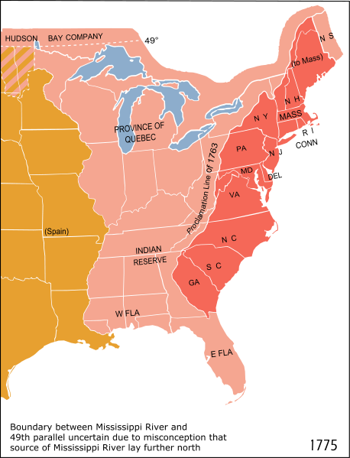
Key Concept 2.1, III
C) Interactions between Natives and Europeans:
Fostered (promoted the growth of) both accommodation and conflict
Europeans allied with Native groups against opposing Native groups
Pequot War, Metacom’s War
British were able to offer more goods to natives, whereas the French were more tolerant of natives (and intermarried with natives)
During the French and Indian (7 Years) War, almost all natives were allied with the French – not the Iroquois
D) European and colonial interests often varied:
Both sides increasingly distrusted each other
British colonists sought to expand (especially post 7 Years’ War), Britain forbade it
Frontier defense became a major issue –seen in Bacon’s Rebellion
Trade divided the two groups – colonists smuggled to get around British taxes

Slide 10
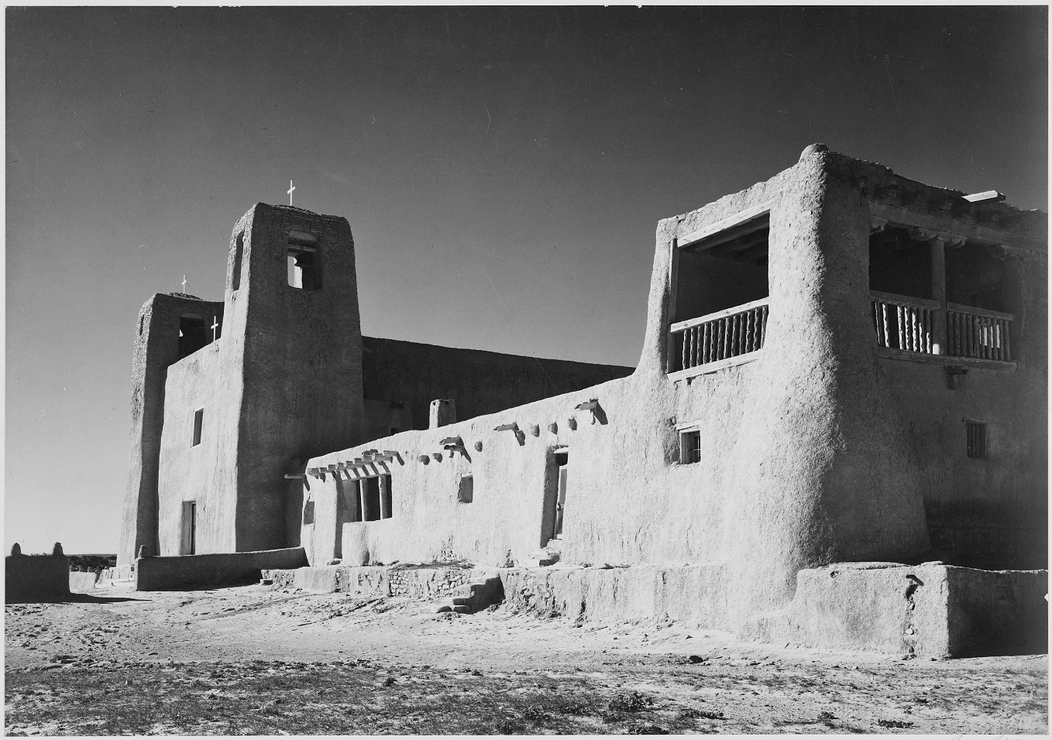
Key Concept 2.1, III
E) British and Native American conflicts:
Were caused by:
Competition over land, resources, and boundaries
Led to military conflicts:
Metacom’s War (King Philip’s War) – see video in description
Conflict between Natives and British colonists in New England
Natives were defeated, not much of a threat thereafter in New England
F) Spanish and Native American resistance:
Pueblo Revolt: Pueblo Indians successfully overthrew the Spanish for 12 years
After the Spanish regained control, they became more accommodating to Native American culture, particularly religion

Slide 11
Test Tips
Multiple-Choice and Short Answer Questions:
Goals of European colonization
Differences between British and other colonies
Comparing British colonies (geography, religion, economy)
Essay Questions:
Reasons for the development of slavery
Comparing and Contrasting European colonization – French, Spanish, and English

Slide 12
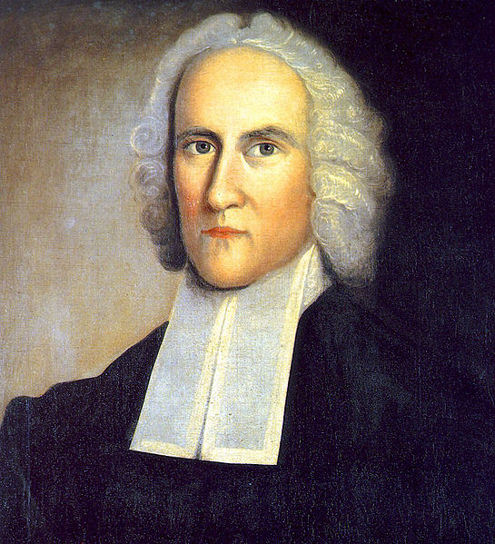
See You Back Here For Key Concept 2.2!
Good luck in May
Please subscribe and share
Check out APUSHReview.com for many more resources

